Slide 1
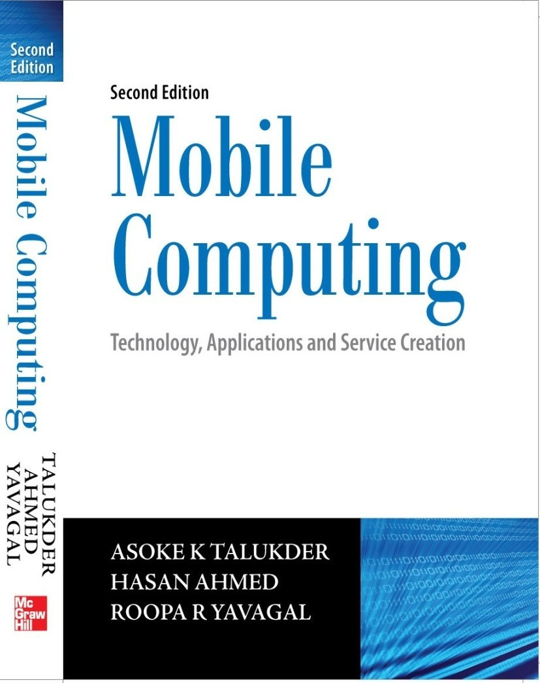
Mobile Computing
Chapter 1 Introduction
Asoke K Talukder Hasan Ahmed
© Tata McGraw Hill

Slide 2
Mobile Computing
Can be defined as “a computing environment over physical mobility”
The user should be able to access data, information, or other logical objects from any device in any network while on the move.
It should allow a user to perform a task from anywhere using a computing device in the public, corporate and personal information spaces.
The communication bearer should be spread over both – wired and wireless media.

Slide 3
Different names of Mobile Computing
VHE – Virtual Home Environment
Anywhere, anytime information
Nomadic computing
Pervasive computing
Ubiquitous computing
Global service portability
Wearable computers
Context aware computing

Slide 4
Attributes of ubiquity
Network Mobility
Bearer Mobility
Device Mobility
Session Mobility
Service Mobility
Host Mobility
User Mobility

Slide 5
Network Mobility
❑ User should be able to move from one network to another network and use the same service.
Example: User moves from Hong Kong to Singapore and uses the same GSM phone to access the corporate application.

Slide 6
Bearer Mobility
❑ User should be able to move from one bearer to another while using the same service.
Example: User is unable to access the WAP bearer due to some problem in the GSM network then he should be able to use voice or SMS bearer to access that same corporate application.

Slide 7
Device Mobility
❑ User should be able to move from one device to another and use the same service.
Example: User is using a PC to do his work. During the day, while he is on the street he would like to use his Palmtop to access the corporate application.

Slide 8
Session Mobility
❑ A user session should be able to move from one user - agent environment to another.
Example: An unfinished session moving from a mobile device to a desktop computer is a good example.

Slide 9
Service Mobility
❑ User should be able to move from one service to another.
Example: User is writing a mail. Suddenly, he needs to refer to something else. In a PC, user simply opens another service and moves between them. User should be able to do the same in small footprint wireless devices.

Slide 10
Host Mobility
❑ User should be able to move while the device is a host computer.
Example: The laptop computer of a user is a host for grid computing network. It is connected to a LAN port. Suddenly, the user realizes that he needs to leave for an offsite meeting. He disconnects from the LAN and should get connected to wireless LAN while his laptop being the host for grid computing network.

Slide 11
User Mobility
❑ User should be able to move from one physical location to another location and use the same service.
Example: User moves from London to New York and uses the Internet in either place to access the corporate application.

Slide 12
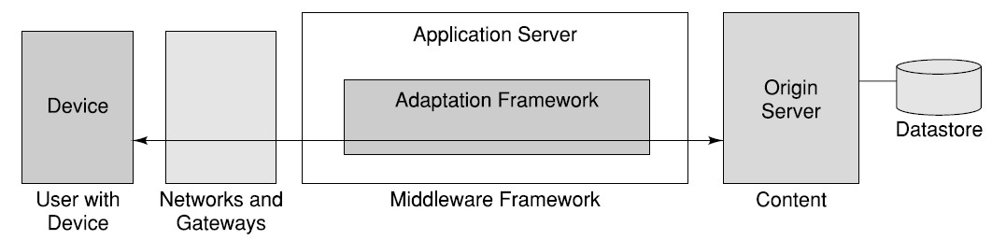
Mobile Computing Functions

Slide 13
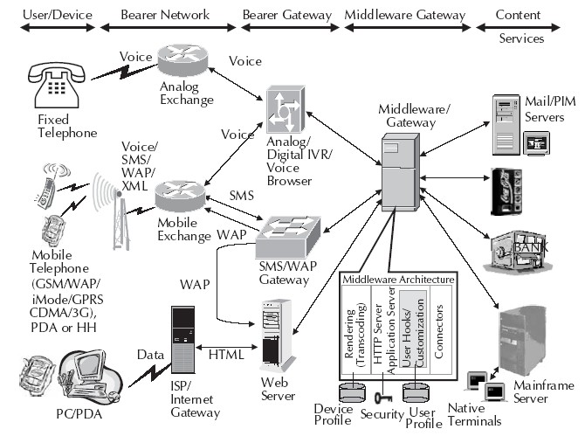
Mobile Computing Environment

Slide 14
Mobile Computing Devices
The usage of devices are becoming more and more integrated.
The Human Computer Interaction (HCI) plays a critical role in effectiveness, efficiency and user experience.
The challenges in HCI are:
Interaction must be consistent from one device to another.
Interaction has to be appropriate for a particular device and environment in which the system is being used.

Slide 15
Dialogue Control
There can be two types of user dialogues:
Long session oriented transactions
Short transactions

Slide 16
Networks for Mobile Computing
Mobile Computing can use different networks such as:
Fixed line telephone networks
GSM
GPRS
ATM
Frame Relay
ISDN
CDMA
CDPD
DSL and many more as such …

Slide 17
Middleware and Gateways
A software layer between a user application and operating system can be termed as middleware. Gateways are deployed when there are different transport bearers or networks with dissimilar protocols. The various types are:
Communication middleware
Transaction processing middleware
Behavior management middleware
Communication gateways
Database middleware
Message oriented middleware

